Slide 1

Academic Year : 2018 - 2019 II Year I - Semester Thermal and hydro prime movers
RAGHU ENGINEERING COLLEGE (Autonomous)
Department of Electrical & Electronics Engineering
CASE STUDY
ON
Properties of steam
Batch No:1
K.karthik(18985AO246)
L.Ratnakar rao(18985AO247)
M.Naidu(18985AO248)
M.Jagapathivarma(18985AO249)
M.sai(18985AO250)
Faculty:
Mr.Mohan sir
Associate professor

Slide 2
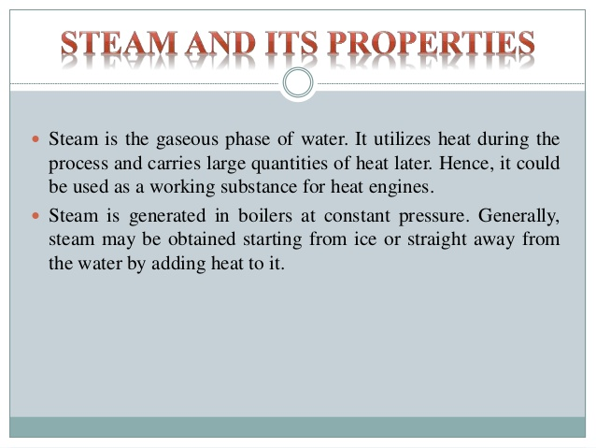

Slide 3
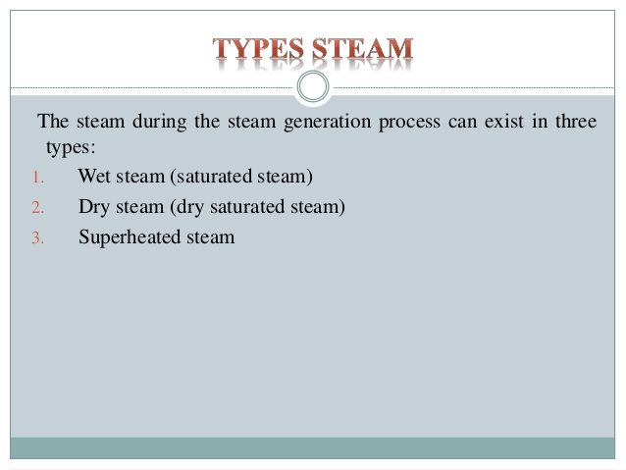

Slide 4
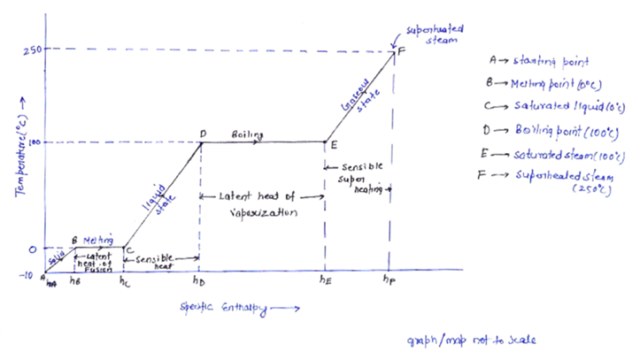

Slide 5
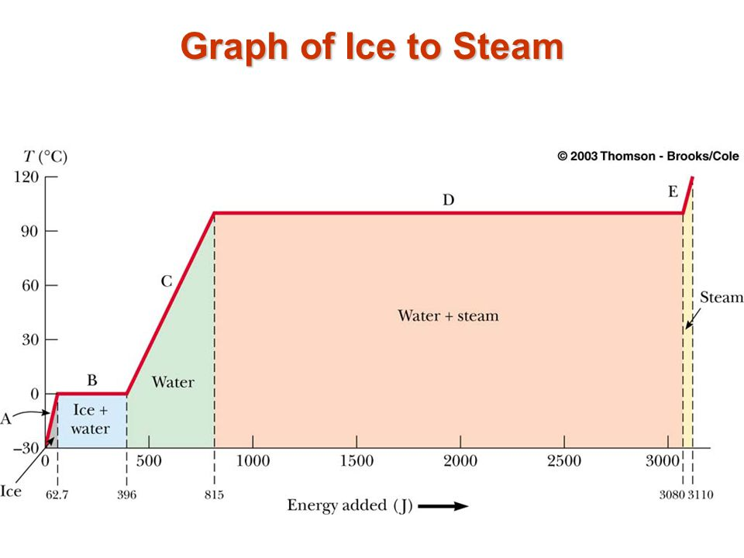

Slide 6
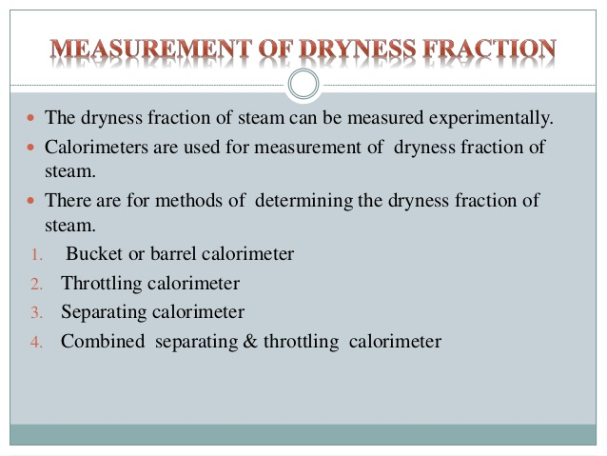

Slide 7
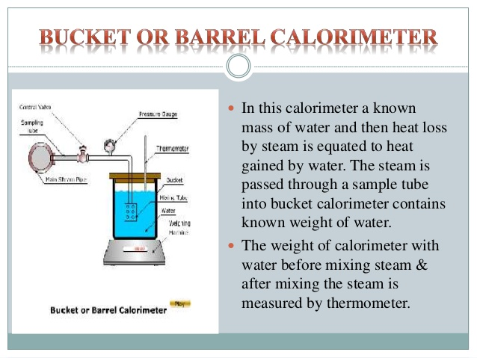

Slide 8
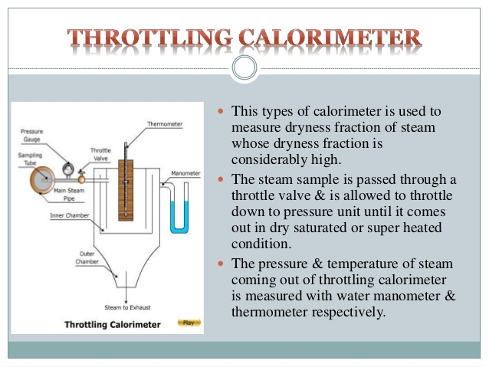

Slide 9
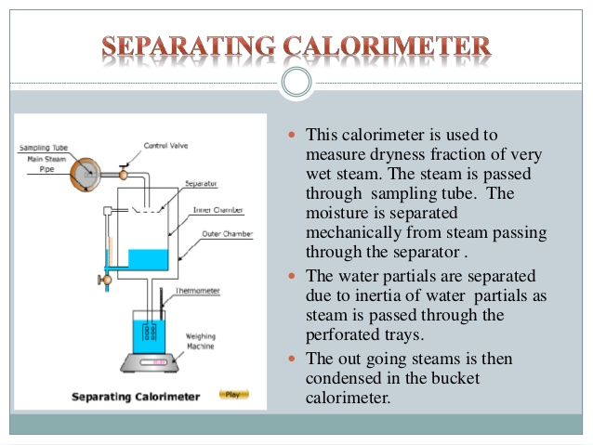

Slide 10
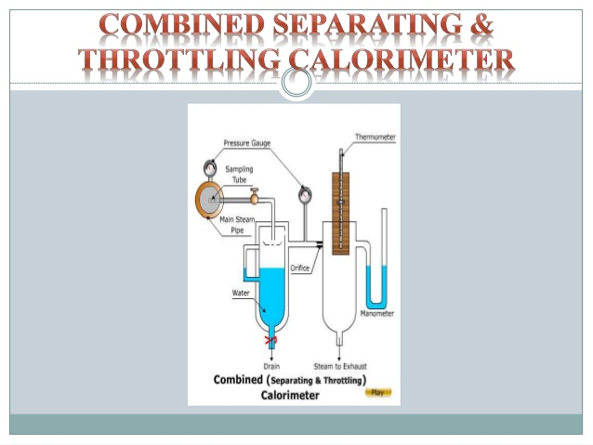

Slide 11
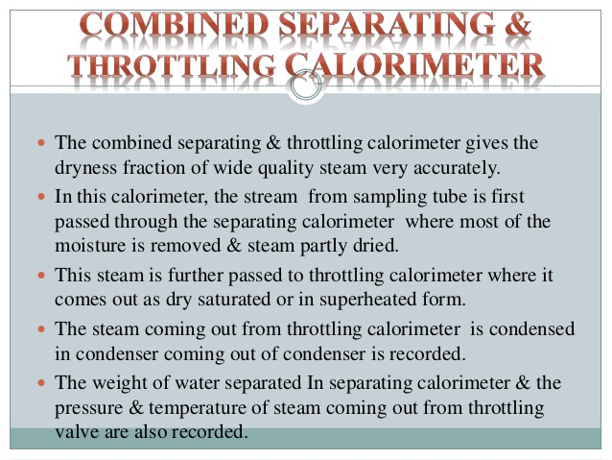

Slide 12


